Slide 1

Toward Super High-Level SDN Programming
Joint project of Caltech, Tongji, Yale
May Wang
Nov. 16, 2016
Notes:
we are now collaborating with Caltech along with some most successful companies to operate a 100Gbps SDN network (photos here)

Slide 2
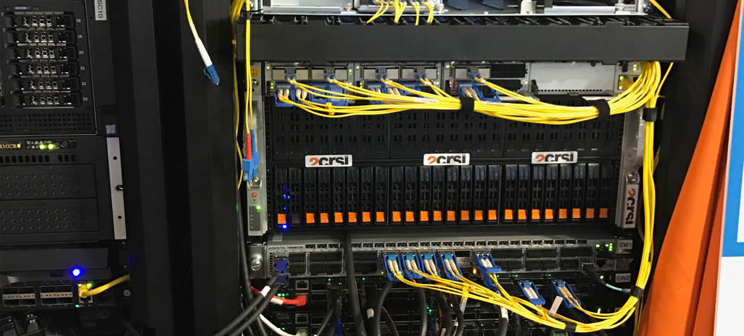
Notes:
We know that super computing depends very much on the support from super network. And what we do is to design and implement super or say, high performance network. To be more specific, what do we do?

Slide 3
Issues in Current SDN Programming
Issue 1: SDN programmers manually write Openflow rules; Openflow is a low level and limited computation model
Openflow does not support logic negation, and hence needs priority to simulate logic negation;
Openflow supports only layer 2 to layer 4, but many decisions depend on higher layers
For more information, please contact us: supersdnprogramming@gmail.com
Notes:
Well, in the network field, we now pay attention to SDN, which is, software defined network, that allows people to define and manage the network by writing code. ( I remember Professor Harvey from Caltech also mentioned this in yesterdays presentation. ) In this way, we can realise the central control of the whole network and don’t need to update the functions by buying new machines, however, we can write code to achieve that.
However, there are still several problems.
First, SDN programmers have to manually write openflow rules which is a low level and limited computation model.

Slide 4
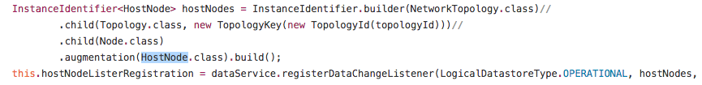

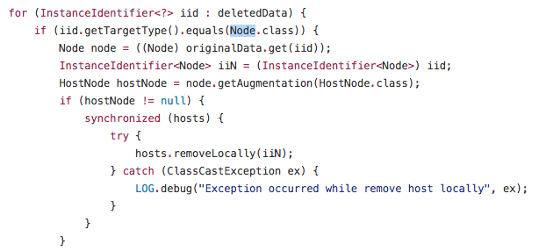
Issues in Current SDN Programming
Issue 2: SDN programmers manually setup listeners for data changes and handle data change events
Manual data tracking leads to a bug in basic system service.
This code is from the l2switch project in ODL
For more information, please contact us: supersdnprogramming@gmail.com
Notes:
Second, programmers need to manually setup listeners for data changes and to handle data change events
L2 switch project
2 parts:
Setup data change listener;
Implement ondadatachange function
Second part will never run

Slide 5
Issues in Current SDN Programming
Issue 3: Complex, manual project lifecycle management.
The state-of-the-art SDN controller is OpenDaylight, OpenDaylight programming requires:
Handle project dependencies (feature.xml …)
Feature/Kar install in karaf console
•••
For more information, please contact us: supersdnprogramming@gmail.com
Notes:
Third, programmers have to face the complex, manual project deployments.
(You don’t know how much time one programmer have to spend on deployment, seriously.)

Slide 6
What is Our Solution?
Low level, limited programming model
Maple
High-level, completely south-bound agnostic, cross-layer (L2-L7) programming
Programmer sees (logically) each and every packet
Integrated access control supporting per-user or role based programming
Low-level, complex, limited (L2-L4) OpenFlow rule programming
Programmer can define only at flow level
Specific access control allowing only hosts partition
FAST
Raw data store
Automatic execution dependency tracking
Automatic cleanup, re-execution (intent ++)
Host generic network functions
Complex, manual tracking of execution dependency
Manual cleanup, re-execute
Designed directly on raw data store
Web-based Integrated Dev Env (IDE)
Manual programming
Web-based automatic generation of projects
Programmer focuses only on policy decision.
Complex, manual maven programming
Notes:
Well, you will say, so many problems, does SDN programming really work? or is it just a concept, a game?
We deploy the system to solve the problems above and we have, indeed, and successfully deployed it on the real switches ( over there ) Yes it really works!

Slide 7

Maple: High-level SDN Programming Language
Consider each pkt as a request
- Network as a single virtual server
- Network functions expressed in general purpose language
- Network functions (logically) invoked on each new packet, returning how net handles that request
- Network decision can depend on L2 to L7
For more information, please contact us: supersdnprogramming@gmail.com
Notes:
To solve the first problem, we provide a programming model, called Maple.
Using Maple, you don’t need to be frustrated by the low level protocol, you write java code, to tell the switches, in this case, how you want the packet to be sent. And Shooo, it will follow your instruction to go there.

Slide 8
Example
Network control based on high-level science data info
1. private static final String[] H12_TAP = { H1, "openflow:1:2", "openflow:2:1" }​
2. private static final String[] H12_ONE = { H1, "openflow:1:2", "openflow:2:3", "openflow:4:1" }​
3. private static final String[] H12_TWO = { H1, "openflow:1:3", "openflow:3:2", "openflow:4:1" } ​
4.​void f(Packet pkt) {​
5. int srcIP = pkt.srcIP(); int dstIP = pkt.dstIP();​
6. String flowId = computeFlowId( srcIP, dstIP, pkt.srcPort, pkt.dstPort, pkt.protocol );​
7. if ( srcIP == H1 && dstIP == H2 ) {​
8. FlowMetadata fm = getFlowMetadata(flowId); ​
9. if ( fm == null ) { ​
10. pkt.addRoute( H12_TAP );​
11. pkt.addRoute( H12_ONE );​
12. } else if ( isScience( getFileName( fm ) ) ) {​
13. pkt.addRoute( H12_TWO );​
14. } else pkt.addRoute( H12_ONE );​
15. } else if ( srcIP == H2 && dstIP == H1 ) {​
16. …​
17. } else pkt.addRoute( Route.drop );​
18. }​
Per-packet
programming
model
Control packets with L7 info
South-bound
agnostic
For more information, please contact us: supersdnprogramming@gmail.com
Notes:
Consider this maple application example which wants to …
Maple app is a lamda function which is not increment function. What if the data changes, … (introduce FAST)

Slide 9
Seamless L2-L4 to L7
If an MapleApp accesses L7 flow info (e.g., file name), system automatically sets up L7 inspection to extract info
Controller
MapleApp { … pkt.flow.fname }
A packet coming in
FlowMetadata
Flow (L7) info
Setup path to tap traffic to Bro
Setup Bro function
How to change the path automatically when FlowMetadata updated?
Bro
Network Monitor Framework
Network
For more information, please contact us: supersdnprogramming@gmail.com
Notes:
To transfer application written by high-level language to low-level flow rules, we design the maple system. the maple system provides a per-packer …which conceptly process every-packet in the network.

Slide 10
FAST: Function Automation System
Hosting generic data-driven network functions
Easy-to-use programming paradigm
Automatic dependency management
Track fine-grained runtime dependency
Subscribe to data changes automatically
Enforced data consistency
Rollback outdated function instances
Re-execute to keep system state up to date
FAST
Add/Remove
Generic Network Function
Function Instance Store
State update
Listener sub
Network
Data Read/Write
Data Store
For more information, please contact us: supersdnprogramming@gmail.com
Notes:
To solve the second problem, we provide FAST, that it can automatically manage the resources, dependencies, to keep the consistency. You may not understand how complex it is for SDN programmers to adjust the dependencies, but if I mention it can automatically keep the consistency, I believe all of you will understand how important it is.…
When state changes, …

Slide 11
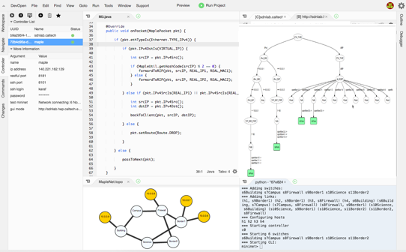
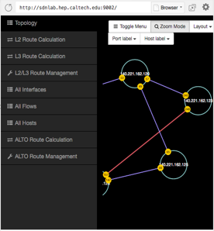
Web SDN IDE
Simplify the deployment process
Connect to multiple controllers
Monitor controller state
Controller management
Automatically generate Mininet topology scripts
Write Maple application
Check the TraceTree for debugging
Show topology
Check routes and flow tables
Network simulator
One-click deployment
Development and debugging
Topology and routes management
For more information, please contact us: supersdnprogramming@gmail.com
Notes:
Also, we provide the SDN IDE, which is much more powerful than usual IDEs. Not only to write SDN codes, you can also test them by graphically creating a network environment, in our IDE. You can directly deploy the code by clicking a button, instead of spending a lot of time to fight with ODL, which is a super complex SDN platform for programmers.

Slide 12
Summary: New Super SDN Programming Tools
User Programmer
MapleApp: A program written by java
Web SDN IDE: Dev, Op, User interfaces
Maple Lib: Read pkt fields, add route
System
Maple Runtime: Record the operations (read which fields) on packets and generates rules
FAST: Track runtime data dependence & re-execute when data changes happen
Network Information Base: Provide network state, southbound driver
Network
Openflow Switch
Openflow Switch
Openflow Switch
For more information, please contact us: supersdnprogramming@gmail.com
Notes:
Therefore, to resolve these issues, we designed a series of tools to simplify sdn control programming.
Control space

Slide 13
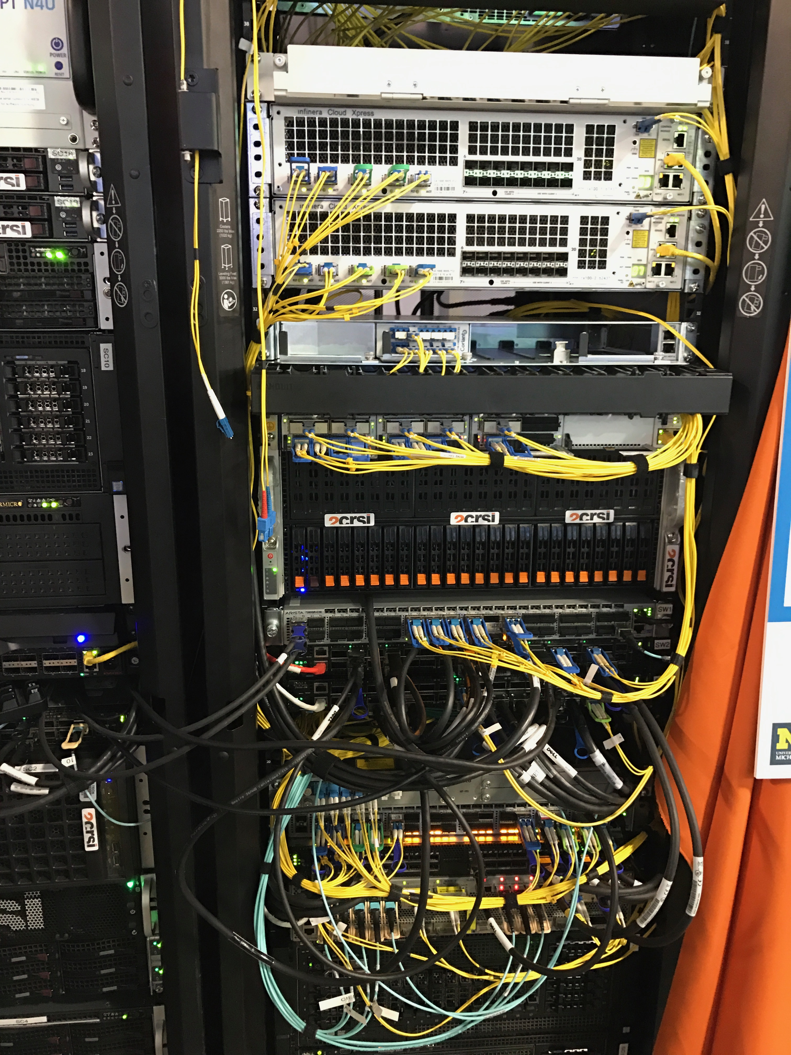
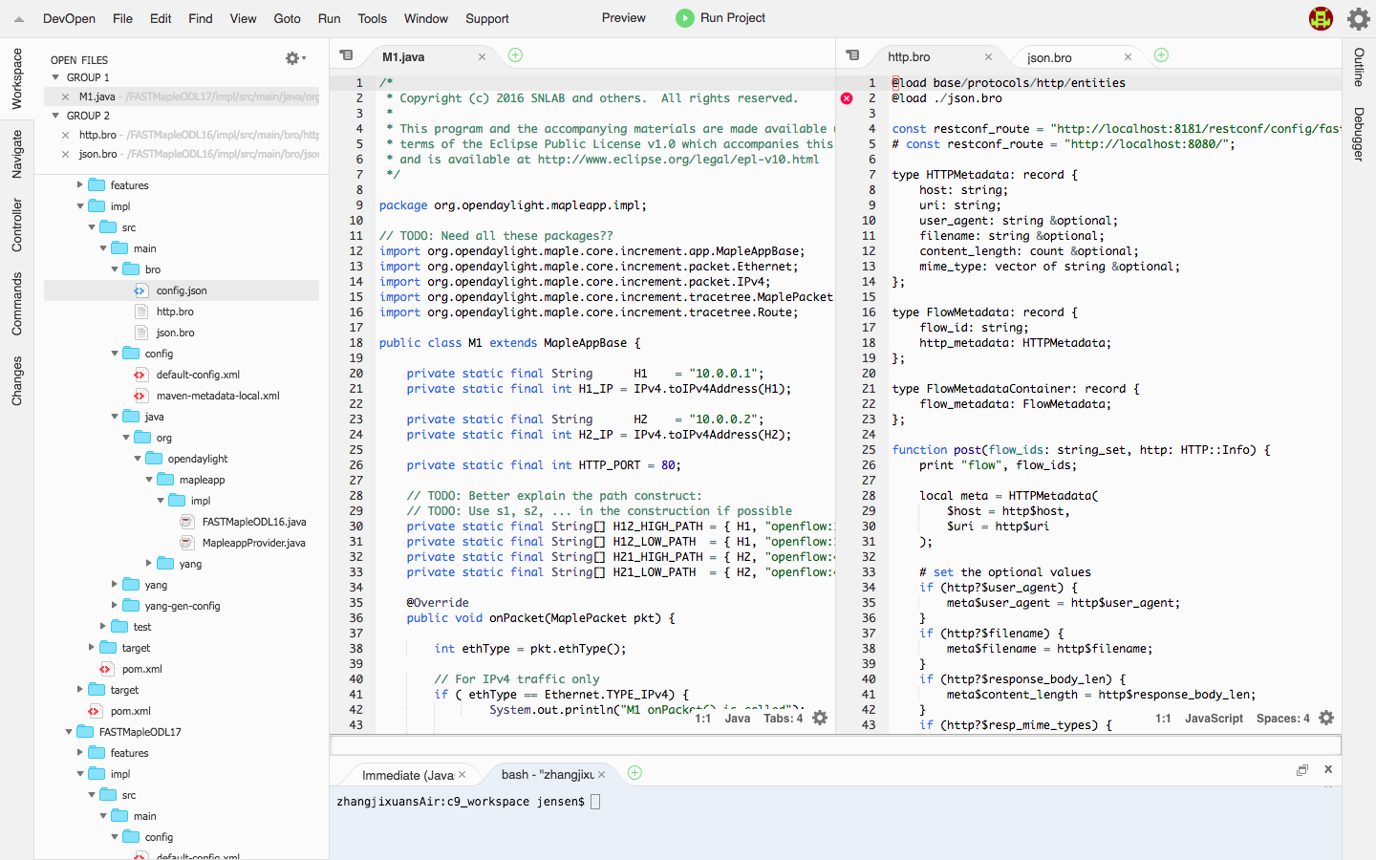
DEMO: Control Traffic based on L7 (HTTP Info)
http.bro
MapleApp.java
Step of Demo:
Controller
1. User writes & deploys MapleApp program in Web IDE.
Bro (sc9)
Bro is a network monitor framework, in which we can get HTTP info for flows.
S3
S5
Server (sc8)
Client (sc6)
S2
2. Client sends a request for science data at the Server.
S1
System generates a path to forward the traffic to Bro to get HTTP info (also forward the traffic to Dst by a default path).
S4
Bro will update the controller with the HTTP info.
Client requests for science data (based on the info by file name in HTTP)
System will compute the correct path based on HTTP info.
TRUE
Path: S1 → S4 → S5
3. Client sends a request for other type data at the Server.
FALSE
Path: S1 → S2 → S3 → S5
For more information, please contact us: supersdnprogramming@gmail.com

Slide 14

Thank You

